Slide 1

Cox Regression … and a review of the hazard function
Steve Simon for
Notes:
Analyzing Repeated Measures Data Workshop: Module 5 The Linear Mixed Model
Copyright 2011 The Analysis Factor http://TheAnalysisFactor.com
1

Slide 2
Abstract
When you have data measuring the time to an event, you can examine the relationship between various predictor variables and the time to the event using a Cox proportional hazards model. In this talk, you will see what a hazard function is and describe the interpretations of increasing, decreasing, and constant hazard. Then you will examine the log rank test, a simple test closely tied to the Kaplan-Meier curve, and the Cox proportional hazards model.

Slide 3
Rates versus proportions
There is an important, but subtle distinction
Both proportions and rates involve division.
A proportion is a count divided by another count.
It can never be larger than 1.
A rate is a count divided by a measure of time (or sometimes area).
It can sometimes be larger than 1.

Slide 4
What is a hazard function?
Start with a hypothetical example
Consider a hypothetical survival distribution.
Simple from a mathematical perspective.
But not too realistic (hence the “hypothetical”)
For those who are curious, this is a Weibull distribution

Slide 5
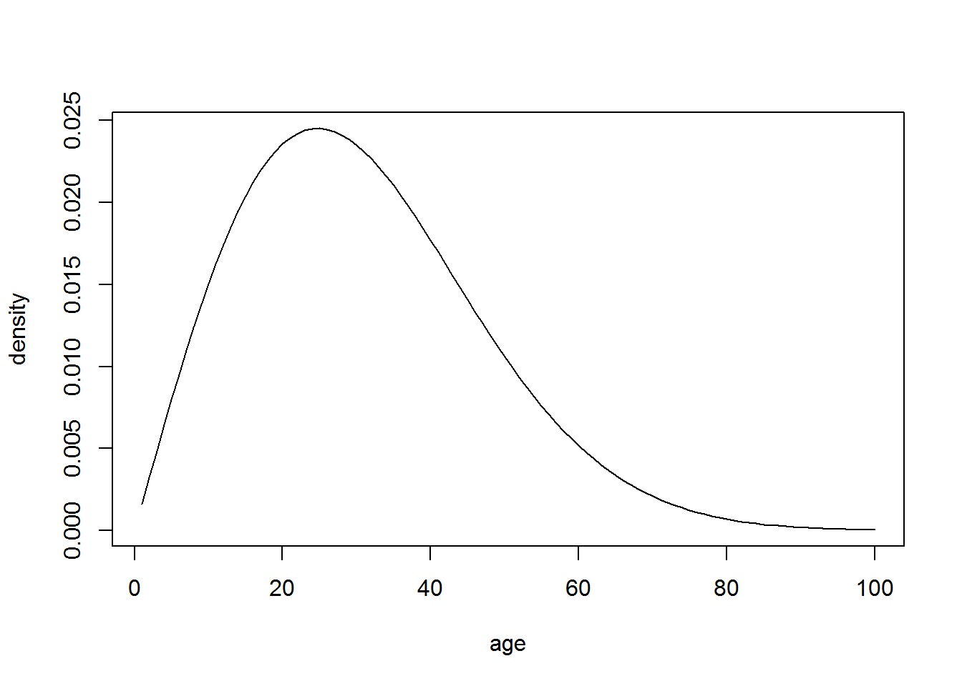

Slide 6
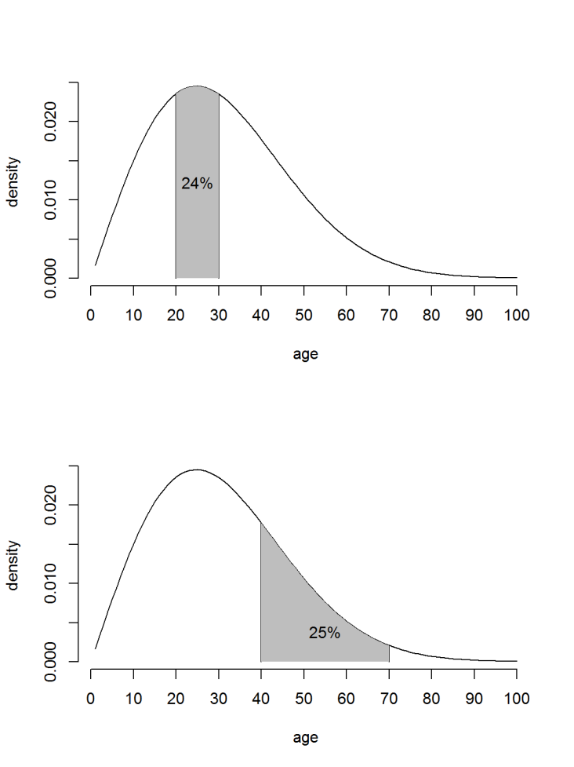

What is a hazard function?
Two mortality probabilities
The probability that you will die young (20-30 years old) is 24%
The probability that you will die middle-aged (40-70 years old) is 25%.

Slide 7
What is a hazard function?
An unfair comparison?
Now these are interesting probabilities, but they are not directly comparable for two reasons.
The probabilities are over different time frames.
The probabilities should be adjusted to account for the smaller number of survivors at the older ages.

Slide 8
What is a hazard function?
Adjusting the probabilities
To adjust for different time intervals.
2,418 funerals per ten thousand people, divided by 120 months yields a rate of 20.2 funerals per month per ten thousand people.
2,526 funerals per ten thousand people, divided by 360 months yields a rate of 7.02 funerals per month per ten thousand people.
To adjust for different survival rates.
72% survive to age 20, so the adjusted rate is 20.2 / 0.72 = 28.1 funerals per ten thousand people alive at age 20.
27% survive to age 40 and beyond, so the adjusted rate is 7.02 / 0.27 = 26.0 funerals per month per ten thousand people alive at age 40.

Slide 9
What is a hazard function?
Calculating a hazard function
The hazard function follows a similar path.
h(t) = (P[t ≤ T ≤ T+Δt] / Δt) / P[T ≥t]
where Δt is very small.
You may see this in different forms (e.g., f(t) / S(t)), but the key things to remember are
it‘s a rate (P[t ≤ T ≤ T+Δt] / Δt)
And it‘s adjusted for the number surviving to that time (P[T ≥t])

Slide 10
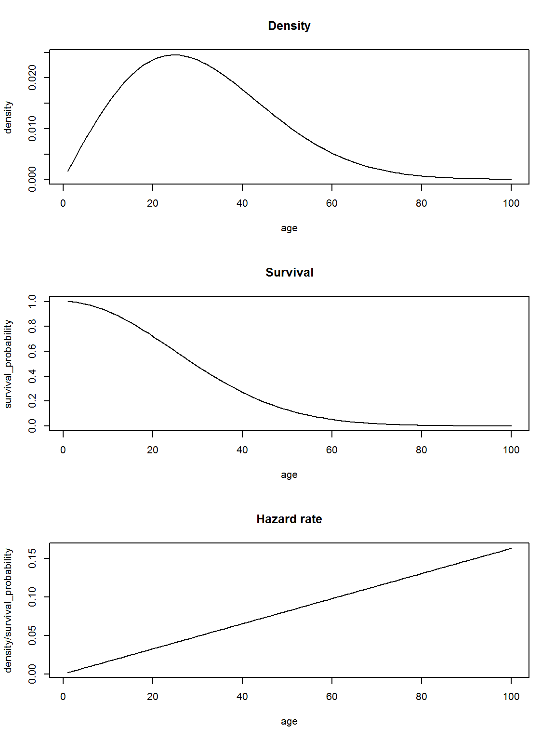
What is a hazard function?
An increasing hazard
With a little bit of basic Calculus, you can show that the hazard function is the density function divided by the survival function.
The example we have been looking at is an example of an increasing hazard function. The death (or failure) rate increases with time.

Slide 11
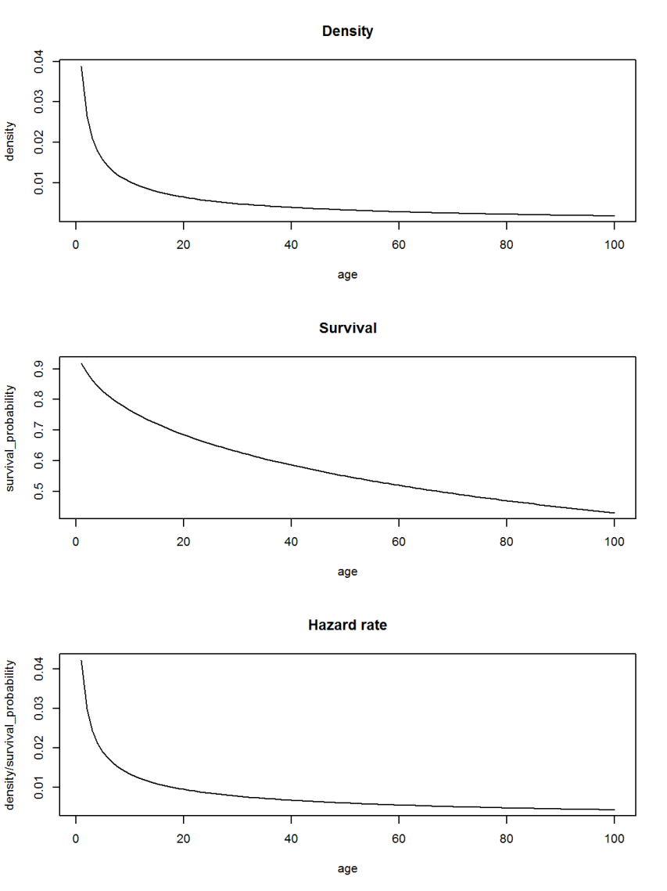
What is a hazard function?
A decreasing hazard
Here is a different density function.
It illustrates a decreasing hazard function. It illustrates the saying “that which does not kill us makes us stronger.” In the context of manufacturing, it illustrates the concept of “used better than new.”

Slide 12
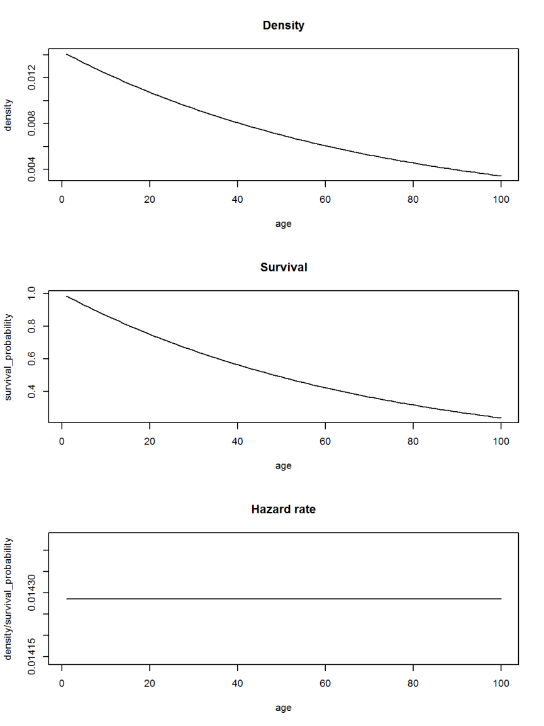
What is a hazard function?
A constant hazard
The last example is an exponential density. It illustrates a constant hazard function.
The expected remaining life is independent of the age of the product. This is sometimes called the “memoryless” property of the exponential distribution.

Slide 13
What is a hazard function?
Why is the hazard function important?
Knowledge of the hazard function for an industrial product can help you decide on how and when to employ preventive maintenance.
It can also help you extrapolate survival patterns beyond the range of observed values, such as for long-term reliability testing.
If you are planning a new research study, the hazard function can help you decide how many patients to study and the length of follow-up for these patients.
Assumptions about the hazard function are critical for regression models of survival.

Slide 14
The log-rank test
Formulation
Before we tackle the Cox proportional hazards model, we need to review the log-rank test. The formula is a bit opaque.
O_{ij} is the number of events in the i^{th} group at time t_{j} (i=1,2)
N_{ij} is the number of patients at risk in the i^{th} group at time t_{j}
O_{j} = O_{1j} + O_{2j}; N_{j} = N_{1j} + N_{2j}

Slide 15



The log-rank test
Formulation found at Wikipedia
The log rank test relies on the hypergeometric distribution. The mean and variance of the hypergeometric distribution are
The logrank test statistic is

Slide 16


The log-rank test
A simpler formulation
This looks a bit mystifying, but if you define
then the mean and variance of the hypergeometric distribution are
The first half of the variance is a binomial variance and the second half is a finite population correction factor.

Slide 17
The log rank test
Limitations
The log rank test
works well when you’re comparing a treatment group to a control group
you can also use it when you have three or more groups.
But the log rank test does not extend beyond this:
you cannot include a continuous predictor,
you cannot analyze data with multiple predictors, and
you cannot do risk adjustment.

Slide 18

The Cox proportional hazards model
Proportional hazards assumption
The Cox model overcomes all of these limitations. But the Cox model makes a critical assumption that is not strictly required for the log rank test, the assumption of proportional hazards.
In mathematical terms, the Cox model assumes that the hazard function for a set of predictor variables X_{i1}, X_{i2}, …, X_{ip},
is proportional to a baseline hazard,

Slide 19

The Cox proportional hazards model
Proportional hazards assumption
In other words,
The likelihood that the failure will occur at time t in the i^{th} observation is
where the summation in the denominator is across all patients at risk at time t. The baseline hazard cancels out, which greatly simplifies the problem.

Slide 20
An example
Methadone clinic discharge data
On the Australian Data and Story Library website, you can find a data set on the amount of time that a patient spends in a rehabilitation clinic. You can read a description of the data at
http://www.statsci.org/data/oz/heroin.html
and the tab delimited data is at
http://www.statsci.org/data/oz/heroin.txt

Slide 21
An example
Variables in the data set
Clinic 1 or 2
Status 0=still in clinic at end of study(censored)
or 1=departed from clinic
Time days spent in clinic
Prison 1=prison record or 0=no record
Dose methadone dosage (mg/day)

Slide 22
An example
First few rows of data
ID Clinic Status Time Prison? Dose
1 1 1 428 0 50
2 1 1 275 1 55
3 1 1 262 0 55
4 1 1 183 0 30
1 1 259 1 65
...

Slide 23
An example
Descriptive statistics for continuous data
Time
Min. 1st Qu. Median Mean 3rd Qu. Max.
2.0 171.2 367.5 402.6 585.5 1076.0
Dose
Min. 1st Qu. Median Mean 3rd Qu. Max.
20.0 50.0 60.0 60.4 70.0 110.0

Slide 24
An example
Descriptive statistics for categorical data
Clinic 1 2
163 75
Status 0 1
88 150
Prison 0 1
127 111

Slide 25
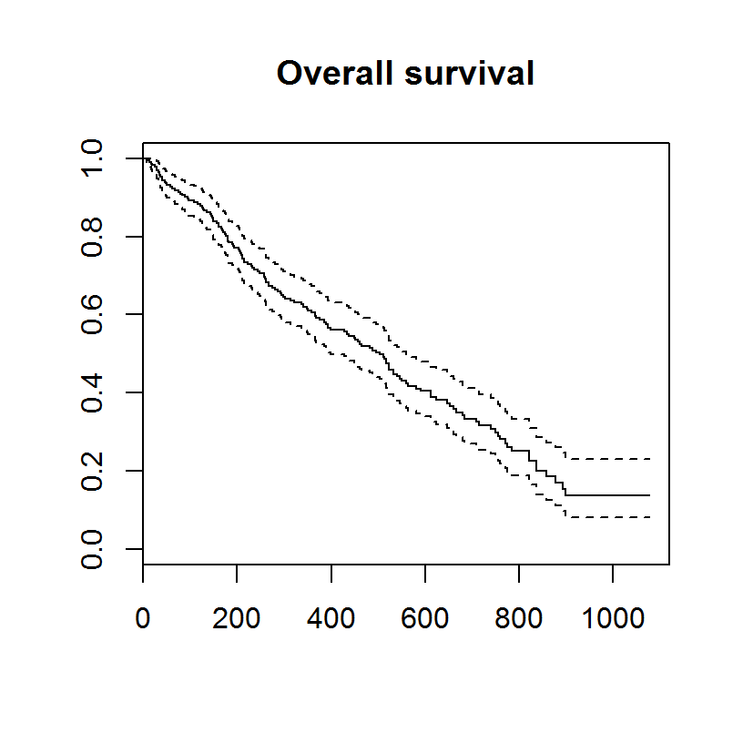
An example
Overall Kaplan-Meier curve
## $quantile
## 25 50 75
## 212 504 821
##
## $lower
## 25 50 75
## 180 399 739
##
## $upper
## 25 50 75
## 262 560 892

Slide 26
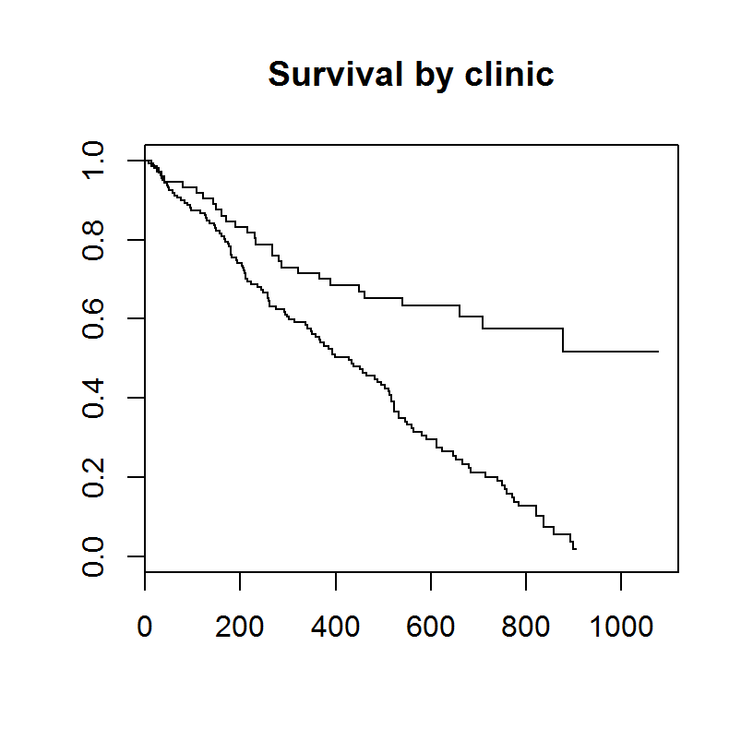
An example
Kaplan-Meier curve for clinic
## $quantile
## 25 50 75
## Clinic=1 192 428 652
## Clinic=2 280 NA NA

Slide 27
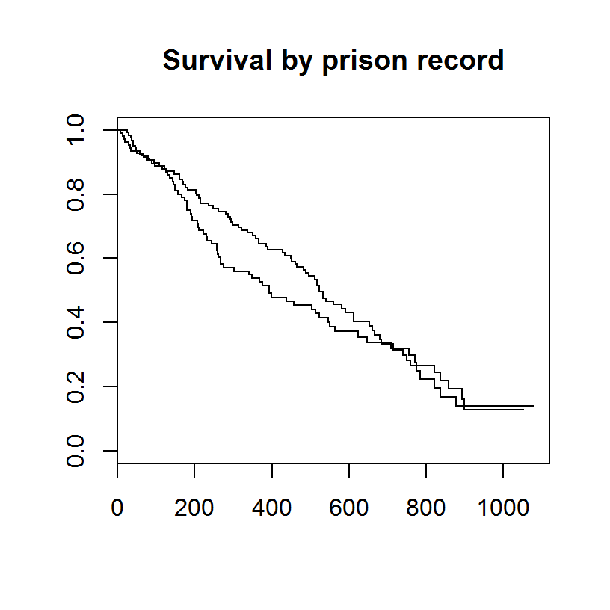
An example
Kaplan-Meier curve for prison
## $quantile
## 25 50 75
## Prison=0 262 523 821
## Prison=1 181 394 774

Slide 28
An example
Log rank test for prison
Log rank test
N Observed Expected (O-E)^2/E (O-E)^2/V
Prison=0 127 81 87.8 0.519 1.26
Prison=1 111 69 62.2 0.732 1.26
Chisq= 1.3 on 1 degrees of freedom, p= 0.262

Slide 29
An example
Cox model for prison
Cox proportional hazards model
coef exp(coef) se(coef) z p
Prison 0.184 1.202 0.164 1.12 0.26
Likelihood ratio test=1.25 on 1 df, p=0.264
n= 238, number of events= 150

Slide 30
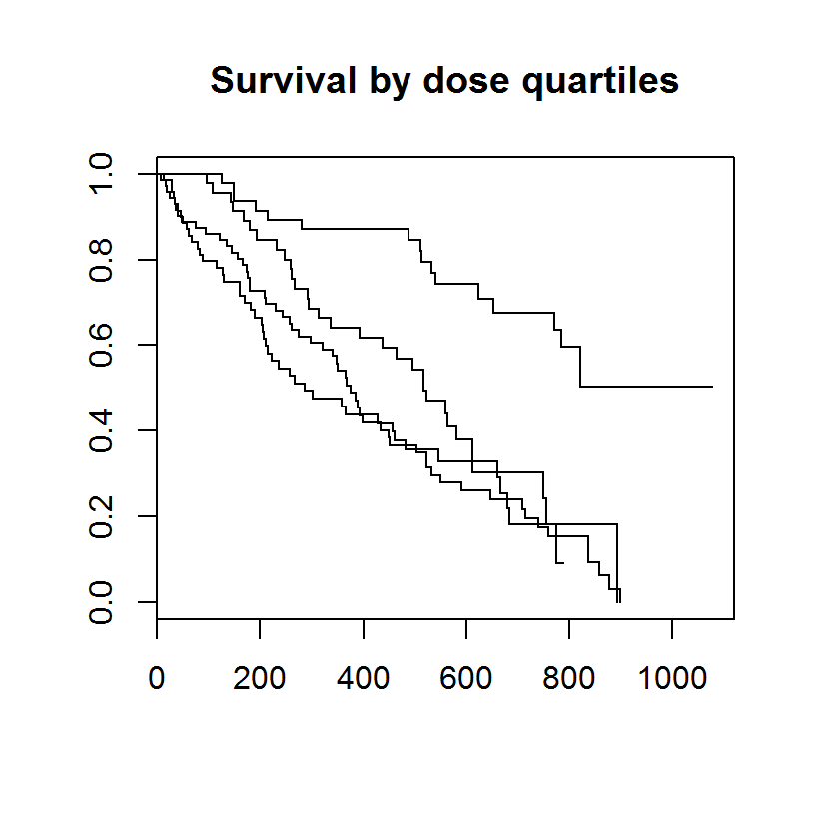
An example
Kaplan-Meier curve for dose quartiles
## $quantile
## 25 50 75
## (0,50] 129 286 679
## (50,60] 180 376 646
## (60,70] 268 518 749
## (70,99] 540 NA NA

Slide 31
An example
Cox model for dose quartiles
Cox proportional hazards model
coef exp(coef) se(coef) z p
(50,60] -0.0412 0.9597 0.2004 -0.21 0.84
(60,70] -0.3409 0.7111 0.2346 -1.45 0.15
(70,99] -1.5304 0.2164 0.2928 -5.23 1.7e-07
Likelihood ratio test=42.5 on 3 df, p=3.19e-09
n= 238, number of events= 150

Slide 32
An example
Cox model with a continuous predictor
coef exp(coef) se(coef) z p
Dose -0.03590 0.96473 0.00598 -6.01 1.9e-09
Likelihood ratio test=36.9 on 1 df, p=1.25e-09
n= 238, number of events= 15050

Slide 33
An example
Cox model with stratification and multiple predictors
coxph(formula = su ~ strata(Clinic) + Prison + Dose)
coef exp(coef) se(coef) z p
Prison 0.38960 1.47640 0.16893 2.31 0.021
Dose -0.03511 0.96549 0.00646 -5.43 5.6e-08
Likelihood ratio test=33.9 on 2 df, p=4.32e-08
n= 238, number of events= 150

Slide 34
Conclusion
What have you learned today?
The hazard function is the short term death rate among those patients surviving to a specific time.
The log rank test is a simple test for comparing two or more Kaplan-Meier curves.
The Cox regression model allows for continuous predictors and risk adjustment.
The Cox model assumes proportional hazard functions and compares groups using a hazard ratio.

